Slide 1
Towards a Probabilistic Taxonomy of Many Concepts
Wentao Wu, Hongsong Li, Haixun Wang, Kenny Q. Zhu
Microsoft Research Asia

Slide 2
What’s the Goal?
Probase:
injecting common sense into computing
In this paper:
developing ontologies or taxonomies that organize
knowledge with many concepts

Slide 3
The Probase Taxonomy
-fully automatically constructed from the HTML text on the web
-iterative learning to extract knowledge
-use probabilistic approaches to score and rank knowledge

Slide 4
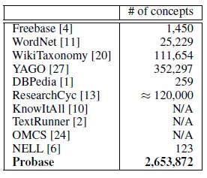

Slide 5
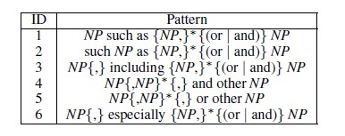
Extracting Knowledge
isA relationship is the most important in knowledge
Hearst Patterns
NP stands for noun phrase

Slide 6

Extracting Knowledge
extract isA pairs from given sentences

Slide 7




Problems
… animals other than cats such as dogs …
animals
cats
isA
isA
dogs
dogs

Slide 8
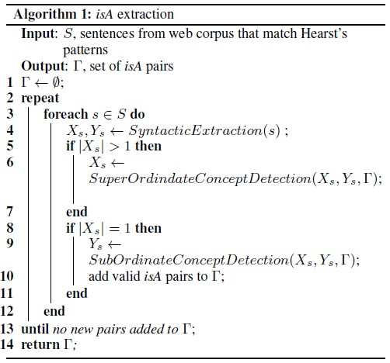
Iterative learning algorithm

Slide 9
Iterative Learning Algorithm
Syntatic Extraction:
-find candidate super-concepts Xs and sub-concepts Ys from a given sentence s.
SuperConceptDetection
-reduce Xs to a single element
SubConceptDetection
-filter out unlikely Ys

Slide 10
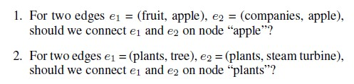
Taxonomy Construction
The taxonomy is modelled as a DAG
An edge (u, v) is to say u is a super-concept of v.
We got the collection of edges by iterative learning.

Slide 11
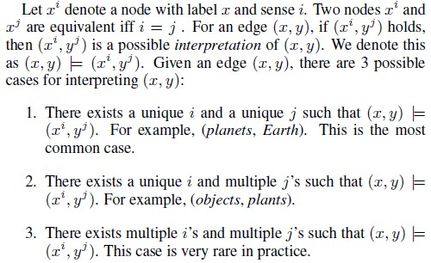
Senses

Slide 12



Properties

Slide 13
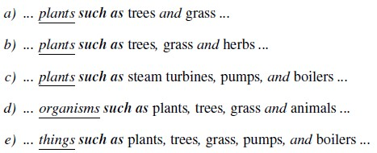
Examples for Properties
A Similarity Function is to be defined here.

Slide 14
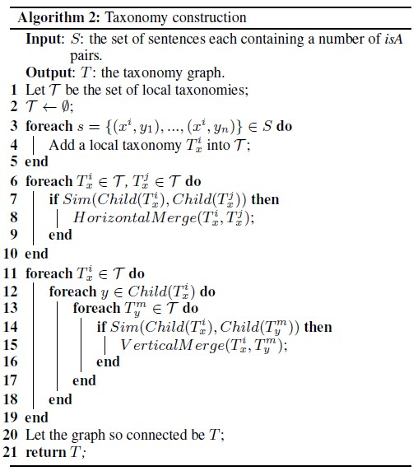
Node Merging Algorithm

Slide 15
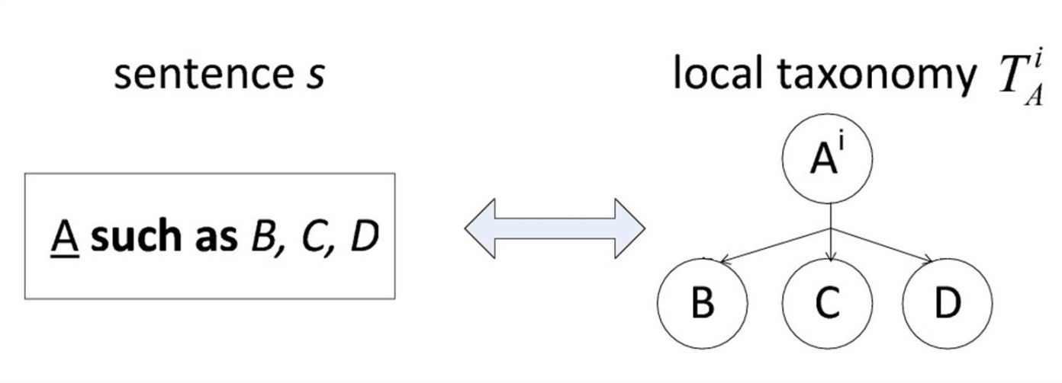
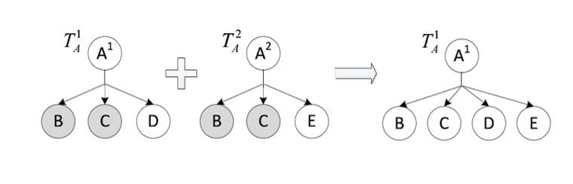
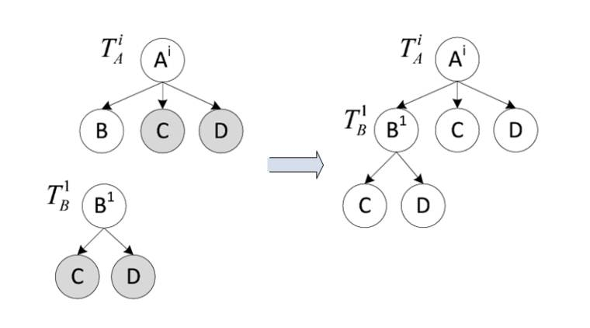
Taxonomy 1

Slide 16
Scoring the Taxonomy
Consensus:
e.g., is there a company called Apple?
Popularity:
e.g., is Apple a top-3 company, or a top-5, or a top-10 company?
Ambiguity:
e.g., does the word Apple, sans any context, represent Apple the company?
Similarity:
e.g., how likely is an actor also a celebrity?
Freshness:
e.g., Pluto as a dwarf planet is a claim more fresh than Pluto as a planet.

Slide 17
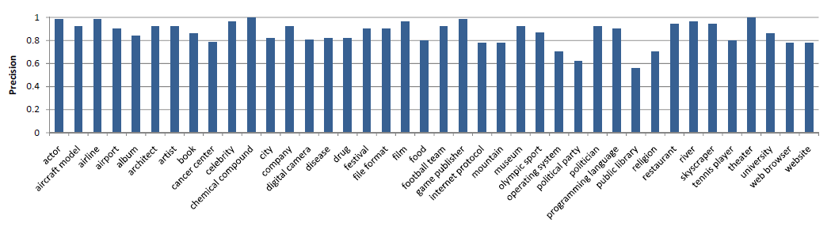
Experimental Results

Slide 18
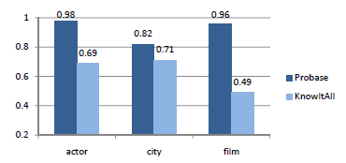
Compare with others

Slide 19
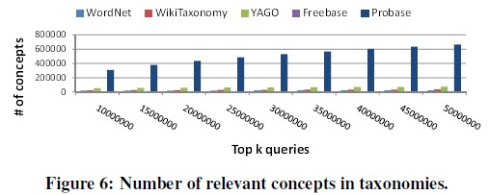
Concept Space

Slide 20
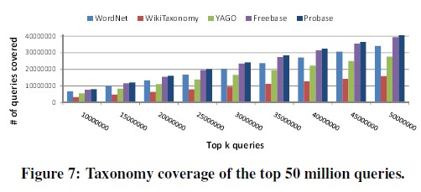
Concept Space

Slide 21
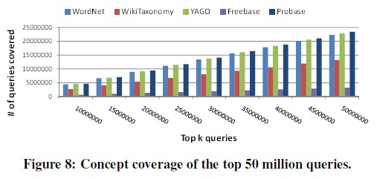
Concept Space

Slide 22
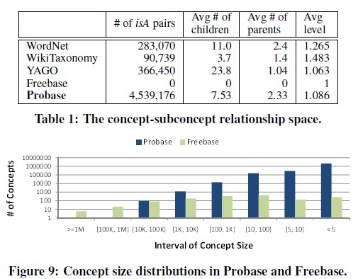
isA Relationship Space

Slide 23
Things not given in detail in this talk
Similarity Function
Scoring Methods
Taxonomy Enriching
Other features

Slide 24
Expanding Concepts
cities
tech companies
basic watercolor techniques
learn swimming
buy books on Amazon
(low order concepts)
noun phrases
noun phrases +
verb +
prepositional phrases
(high order concepts)

Slide 25
Expanding Relationships
Relationships among concepts (noun phrases)
  locatedIn, friendOf, createdBy, etc
  relationship between apple and Newton
Relationships among high order concepts
  causal relationships
  tasks and subtasks

Slide 26
Find questions for answers
For each claim, find all possible of questions that the claim can be used to answer.
<China, population, 1.3 billion>
  Q: How many people are there in China?
For a set of claims of the same class, find possible aggregate questions.
<China, population, 1.3 billion>, <India, population, 1 billion>, …
  Q: What’s the most populous nation?

Slide 27
Thanks!

